Slide 1

Telecommunications, the Internet, and Wireless Technology
Chapter 7
Ali Bazarah
MIS 300

Slide 2
Learning Objectives
7.1 What are the principal components of telecommunications networks and key networking technologies?
7.2 What are the different types of networks?
7.3 How do the Internet and Internet technology work, and how do they support communication and e-business?
7.4 What are the principal technologies and standards for wireless networking, communication, and Internet access?

Slide 3
Networking and Communication Trends
Telephone networks historically handled voice communication, and computer networks handled data traffic
Convergence
Telephone networks and computer networks converging into single digital network using Internet standards
Broadband
High-speed transmission technology.
Designates a single communications medium that can transmit multiple channels of data simultaneously
Majority of U.S. Internet users have broadband access
Broadband wireless
Voice, data communication are increasingly taking place over broadband wireless platforms

Slide 4
What is a Computer Network?
Two or more connected computers
Major components in simple network
Client and server computers
Network interfaces (N I C s )
Connection medium
Network operating system (N O S)
Hubs, switches, routers
Software-defined networking (S D N )
Functions of switches and routers managed by central program

Slide 5
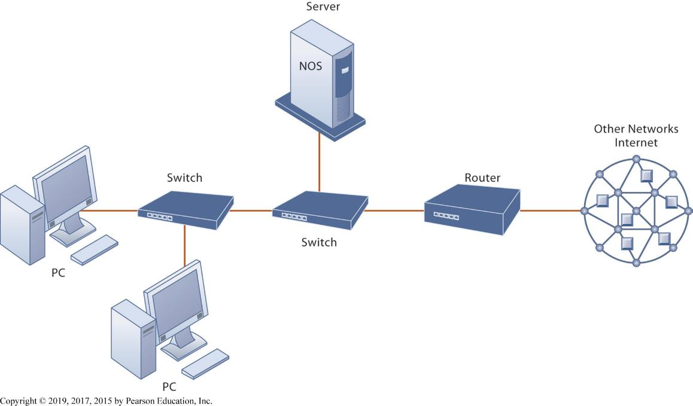
Figure 7.1 Components of a Simple Computer Network
Notes:
Figure 7.1, Page 234.
Illustrated here is a simple computer network consisting of computers, a network operating system (NOS) residing on a dedicated server computer, cable (wiring) connecting the devices, switches, and a router.
Although the NOS is shown as part of the server, note that, depending on the type of software, an NOS may also be designed to reside on client computers (these are called peer-to-peer networks). Do some students have a home computer network? Ask them to describe the elements of the network.

Slide 6
Networks in Large Companies
Large numbers of local area networks (LANs) linked to firm-wide corporate network
Various powerful servers
Website, corporate intranet, extranet
Backend systems
Mobile wireless LANs (Wi-Fi networks)
Videoconferencing system
Telephone network, wireless cell phones

Slide 7
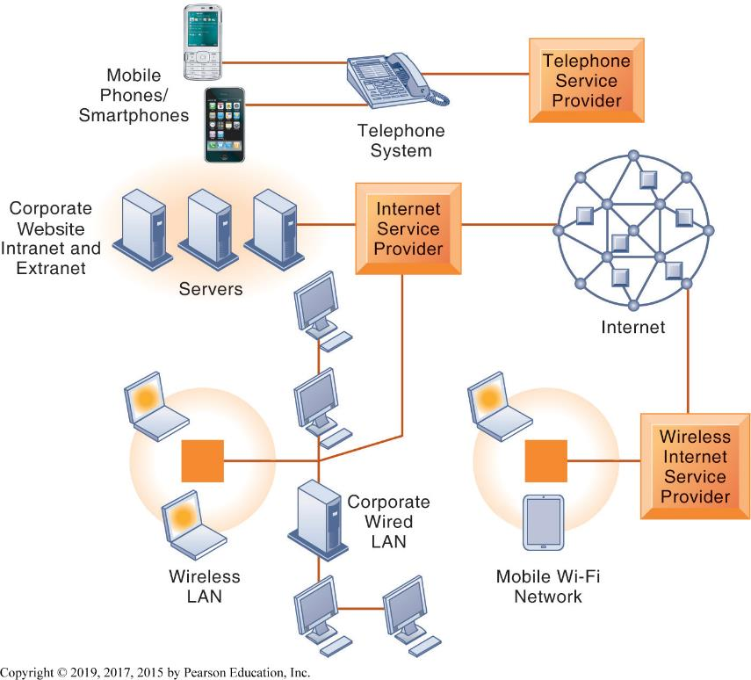
Figure 7.2 Corporate Network Infrastructure
Notes:
Figure 7.2, Page 235.
Today’s corporate network infrastructure is a collection of many networks from the public switched telephone network, to the Internet, to corporate local area networks linking workgroups, departments, or office floors.
This graphic illustrates the components of a large company’s network. Note the difference between the wireless LAN, which allows wireless access within the office, and the mobile Wi-Fi network, which allows Internet access to employees outside of offices. The advantage of telephone-based wireless systems is that they do not require a Wi-Fi hotspot to work, and in fact can connect users to the entire globe through their telephone networks. Cable networks—major competitors of telephone company Internet providers—have recently developed a mobile option. Optimum Cable (Comcast) has installed neighborhood Wi-Fi hot spots, allowing cable subscribers wireless access to the Internet.

Slide 8
Key Digital Networking Technologies (1 of 3)
Client/server computing
Distributed computing model
Clients linked through network controlled by network server computer
Server sets rules of communication for network and provides every client with an address so others can find it on the network
Has largely replaced centralized mainframe computing
The Internet: largest implementation of client/server computing

Slide 9
Key Digital Networking Technologies (2 of 3)
Packet switching
Method of slicing digital messages into parcels (packets), sending packets along different communication paths as they become available, and then reassembling packets at destination
Previous circuit-switched networks required assembly of complete point-to-point circuit
Packet switching more efficient use of network’s communications capacity
Notes:
This slide continues the discussion of the three main networking technologies today, looking at the second, packet switching. Note that circuit-switched networks were expensive and wasted available communications capacity—the circuit had to be maintained whether data was being sent or not. It is also important to note that packet switching enables packets to follow many different paths. What is the advantage of this capability? If one path is blocked due to an accident or power failure, the data will automatically be shifted by routers to open paths. However, in truly massive outages like the September 11, 2011 attack on the World Trade Center, nearby metropolitan servers were knocked out, and for a period of several days, Internet access was limited in the New York Metropolitan area. The notion that packet switching networks would survive a nuclear attack is highly unlikely.

Slide 10
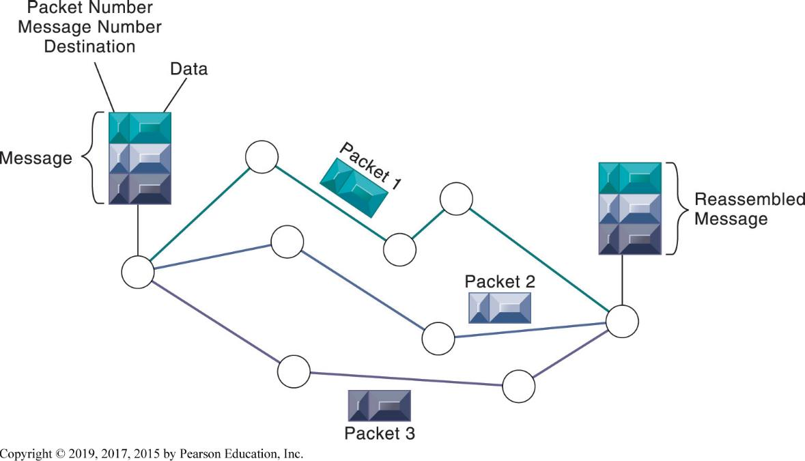
Figure 7.3 Packet-Switched Networks and Packet Communications
Notes:
Figure 7.3, Page 236.
Data are grouped into small packets, which are transmitted independently over various communications channels and reassembled at their final destination.
This graphic illustrates how packet switching works, showing a message being split into three packets, sent along different routes, and then reassembled at the destination. Note that each packet contains a packet number, message number, and destination.

Slide 11
Key Digital Networking Technologies (3 of 3)
T C P / I P and connectivity
Protocols: rules that govern transmission of information between two points
Transmission Control Protocol/Internet Protocol (T C P / I P)
Common worldwide standard that is basis for the Internet.
Handles the movement of data between computers.
Establishes a connection between the computers.
Sequences the transfer of packets.
Acknowledges the packets sent.

Slide 12
TCP/IP
IP refers to the Internet Protocol (IP)
Responsible for the delivery of packets
Includes the disassembling and reassembling of packets during transmission.
Four layers
Application layer: Enables client application programs to access the other layers (http)
Transport layer: Responsible for providing the Application layer with communication and packet services.
Internet layer: Responsible for addressing, routing, and packaging data packets called IP datagrams.
Network interface layer: Responsible for placing packets on and receiving them from the network medium

Slide 13
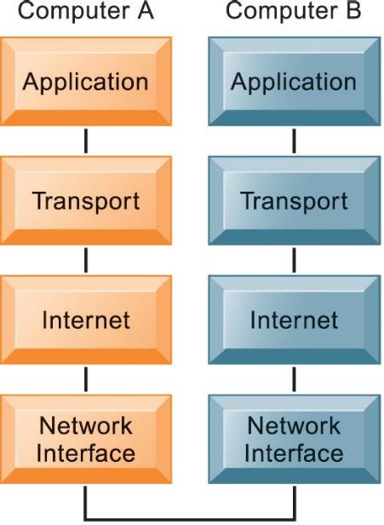
Figure 7.4 The Transmission Control Protocol/Internet Protocol (T C P/ I P) Reference Model
Notes:
Figure 7.4, Page 237.
This figure illustrates the four layers of the TCP/IP reference model for communications.
This graphic illustrates the four layers of the DOD reference model for TCP/IP. Note that what happens when computer A sends a message to computer B is that the data that computer A creates is transferred within that computer from the application layer to subsequent layers in sequence. In this process it is split into packets, and information is added at each stage, ultimately translating the packets into a form that can be transferred over the network interface. After traveling over the network interface, the packets are reassembled at the recipient computer, from the network interface layer up, ultimately for use by the application layer.

Slide 14
How a packet moves through network
https://www.youtube.com/watch?v=xIuBmOufbls

Slide 15
Types of Networks
Types of networks
Local area networks (LANs)
Network that is designed to connect personal computers and other digital devices within a half-mile or 500-meter
Wide area networks (WANs)
Spans broad geographical distances – entire regions, states, continents, or the entire globe
Metropolitan area networks (MANs)
Network that spans a metropolitan area, usually a city and its major suburbs.
Campus area networks (CANs)

Slide 16
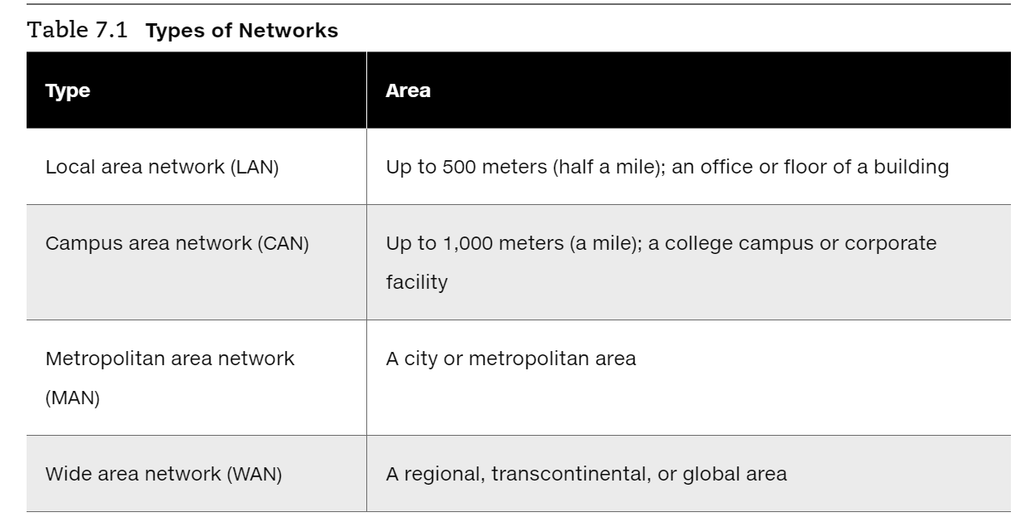

Slide 17
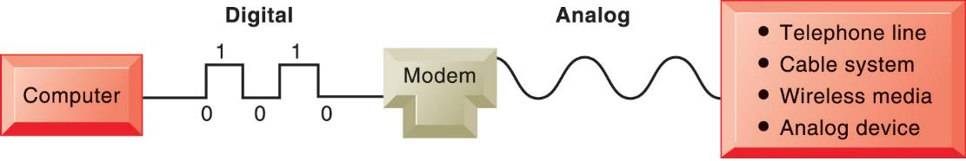
Signals: Digital versus analog
Modem: translates digital signals into analog form (and vice versa)
Analog: a continuous waveform that passes through a communications medium and has been used for voice communication.
Digital: a discrete, binary waveform, rather than a continuous waveform, represented by strings of two states: one bit and zero bits
Notes:
Figure 7.5, Page 238.
A modem is a device that translates digital signals into analog form (and vice versa) so that computers can transmit data over analog networks such as telephone and cable networks.
This graphic illustrates the differences between digital and analog signals, and shows how digital signals can be sent to other computers over analog cables such as telephone and cable lines that are analog. Note that digital signals are representations of the two binary digits, 0 and 1, and are represented logically as on and off electrical pulses (in reality as different voltages). Ask students what MODEM stands for.

Slide 18
Transmission Media and Transmission Speed
Physical transmission media
Twisted pair wire (CAT5)
Coaxial cable
Fiber optics cable
Wireless transmission media and devices
Satellites
Cellular systems
Transmission speed
Bits per second (b p s)

Slide 19
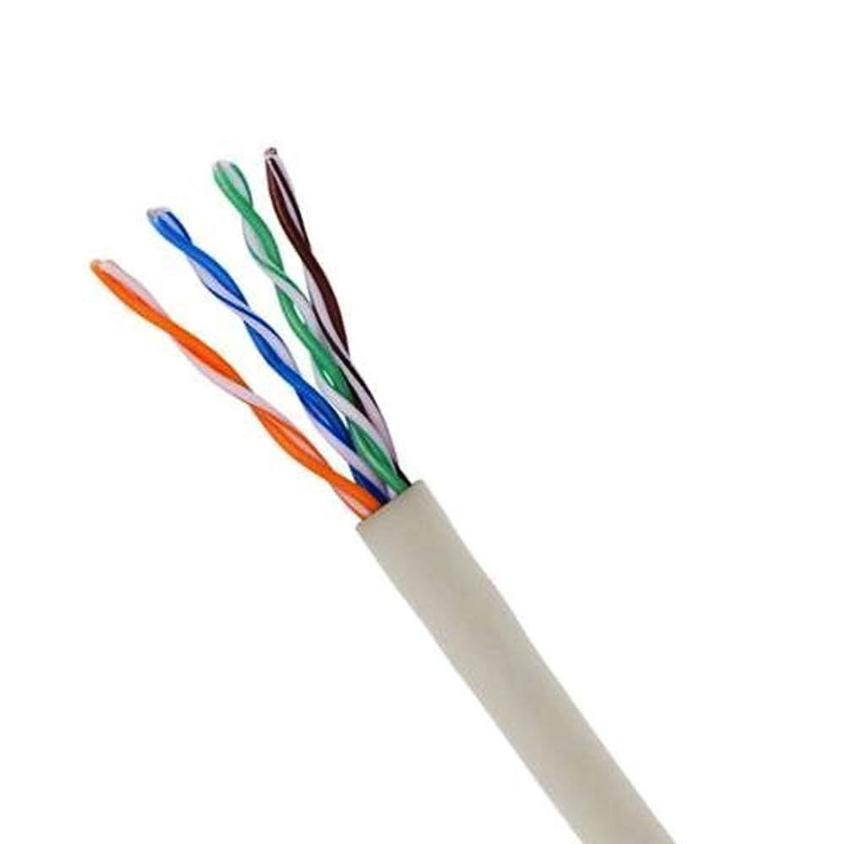
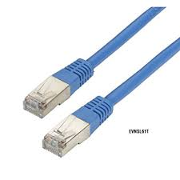
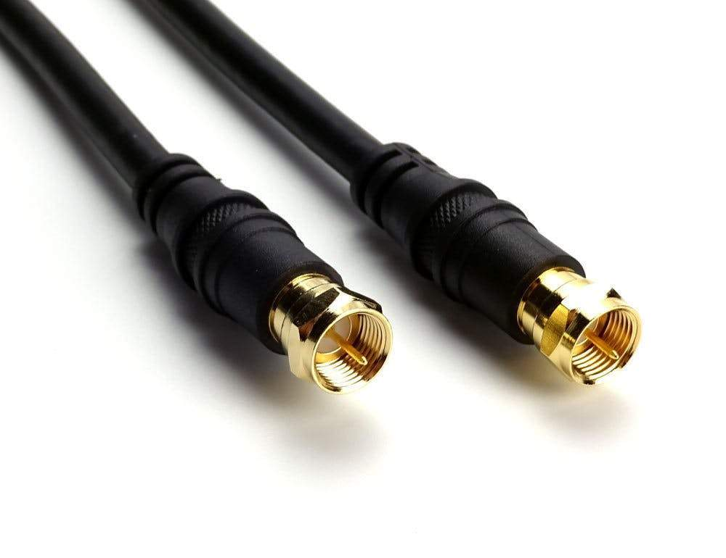
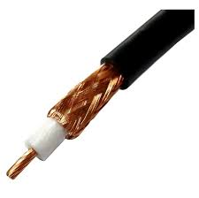
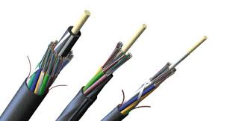

Slide 20
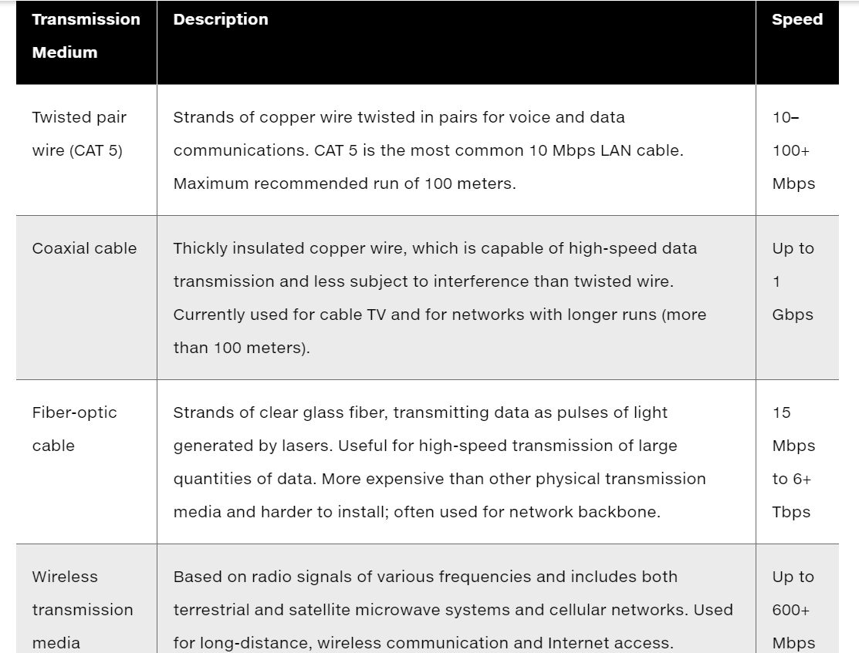

Slide 21
What is the Internet?
The Internet
World’s most extensive network
The internet uses the client/server model of computing and the TCP/IP network reference model.
Every computer on the internet is assigned a unique numeric IP address
Internet service providers (I S P s)
Provide connections
Types of Internet connections
Dial-up: 56.6 K b p s
Digital subscriber line (D S L / F I O S): 385 K b p s –40 M b p s
Cable Internet connections: 1–50 M b p s
Satellite
T1/T3 lines: 1.54–45 M b p s

Slide 22
Internet Addressing and Architecture
Each device on Internet assigned Internet Protocol (I P) address
32-bit number, e.g. 207.46.250.119
The Domain Name System (D N S)
Converts I P addresses to domain names
Hierarchical structure
Top-level domains
https://www.youtube.com/watch?v=2ZUxoi7YNgs

Slide 23
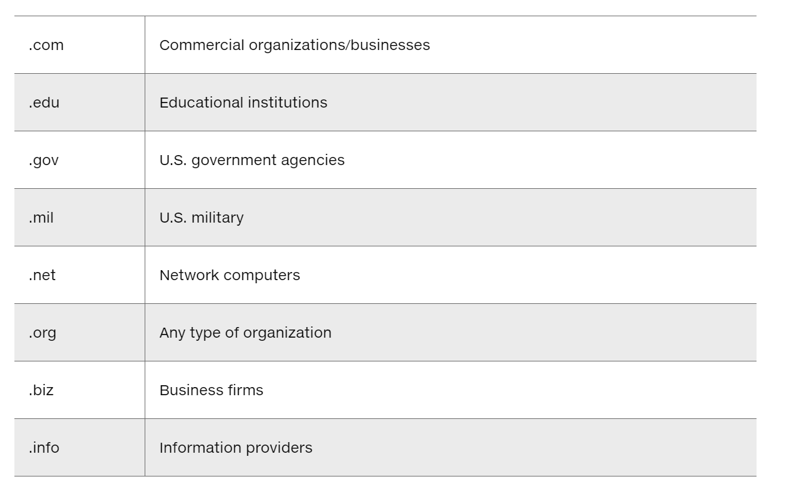

Slide 24
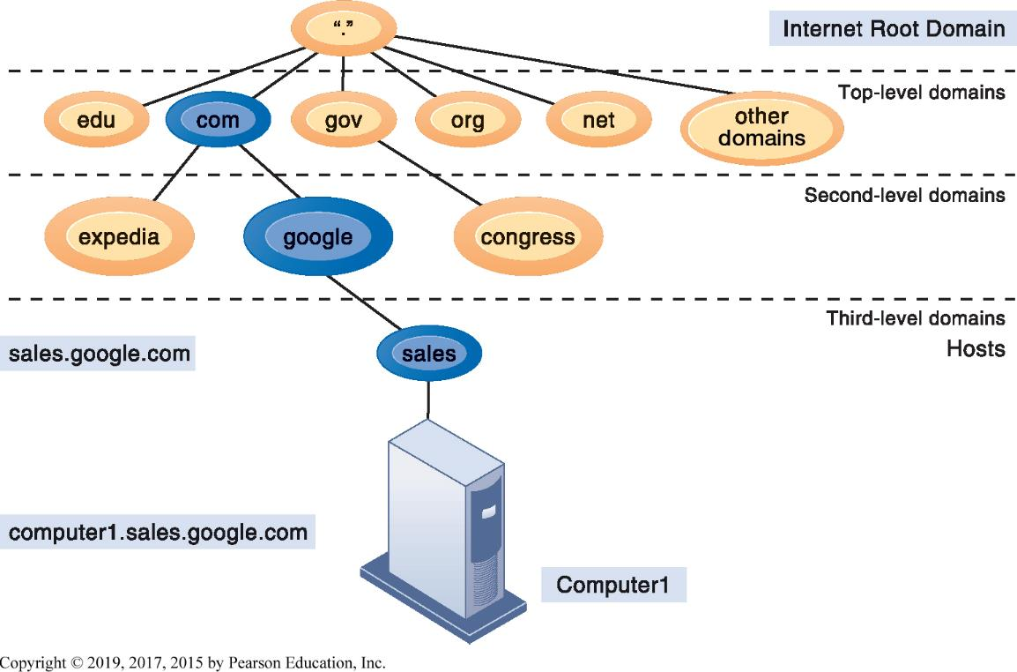
Figure 7.6 The Domain Name System
Notes:
Figure 7.6, Page 241.
Domain Name System is a hierarchical system with a root domain, top-level domains, second-level domains, and host computers at the third level.
This graphic describes how the domain name system works. Note that the “root” domain is the period that is used before the top-level domain, such as .edu or .com. Give students an example Internet address, such as myserver.myspace.com and ask them what the top-, second-, and third-level domains are.

Slide 25
Internet Services and Communication Tools (1 of 2)
Internet services
Email
Chatting and instant messaging
Newsgroups
Telnet
File Transfer Protocol (F T P )
World Wide Web
Voice over I P ( V o I P)
Enables internet technology to be used for telephone voice transmission over the internet or private networks
Digital voice communication using I P, packet switching

Slide 26
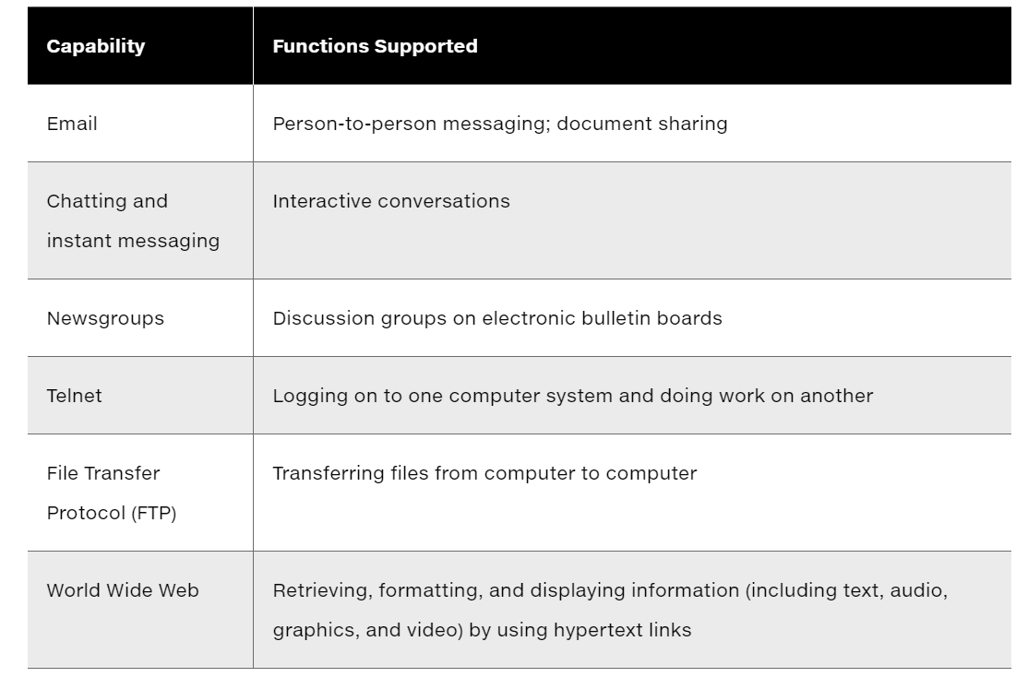
Internet Services

Slide 27
Internet Services and Communication Tools (2 of 2)
Unified communications
Communications systems that integrate voice, data, email, conferencing
Virtual private network (V P N)
Secure, encrypted, private network run over Internet

Slide 28
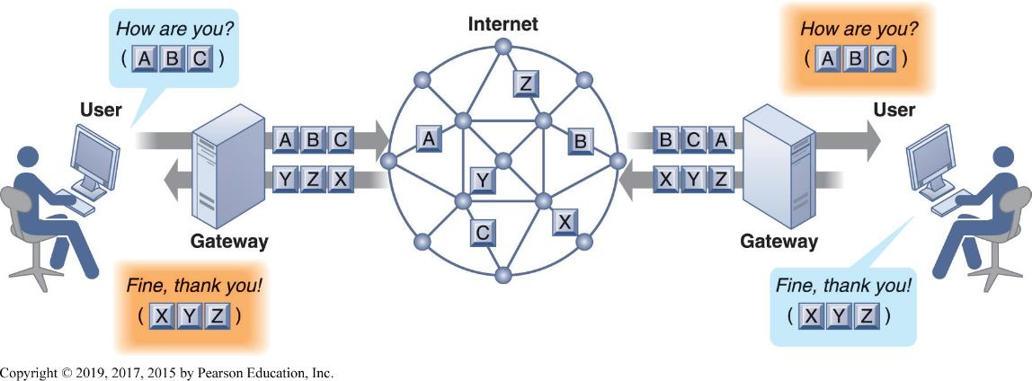
Figure 7.9 How Voice Over I P Works
Notes:
Figure 7.9, Page 246.
A VoIP phone call digitizes and breaks up a voice message into data packets that may travel along different routes before being reassembled at the final destination. A processor nearest the call’s destination, called a gateway, arranges the packets in the proper order and directs them to the telephone number of the receiver or the IP address of the receiving computer.
This graphic shows how VoIP works. The voice messages are digitized and transported over the Internet in the same packet-switching method as traditional Internet data. Gateways are simply computers (network devices) that maintain the interface with the Internet in a firm.

Slide 29
The Web
A system with universally accepted standards for storing, retrieving, formatting, and displaying information by using a client/server architecture.
Hypertext
Hypertext Markup Language (H T M L)
Hypertext Transfer Protocol (H T T P):
Uniform resource locator (U R L):
Web servers
Software for locating and managing web pages

Slide 30
Searching for Information on the Web (1 of 2)
Search engines
Google’s PageRank System
Mobile search
Semantic search: Understand human language using algorithms
Social search: relevant results

Slide 31
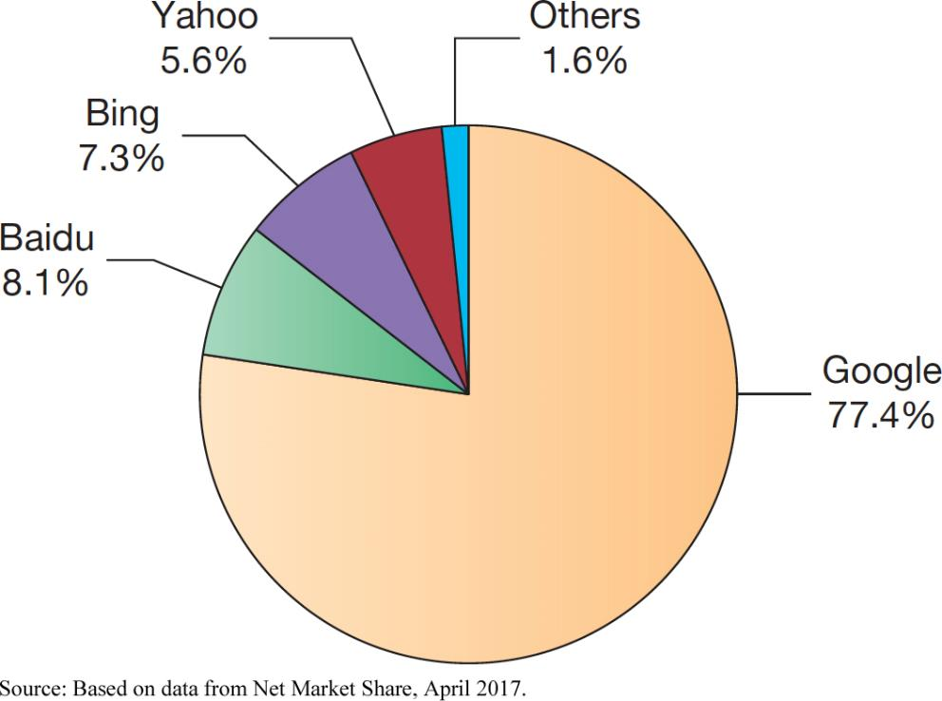
Figure 7.11 Top Web Search Engines Worldwide
Source: Based on data from Net Market Share, April 2017.
Notes:
Figure 7.11, Page 251.
Google is the world’s most popular search engine.
This graphic ranks the major search engines according to popularity, or percentage of total number of searches performed. Google is a clear favorite. Is this due to the superiority of their search engine results or does it involve other factors such as their clean interface, or their reach, which makes their ad platform more valuable to advertisers? Poll your class about the search engines they use.

Slide 32
Searching for Information on the Web (2 of 2)
Intelligent agent shopping bots: use intelligent agent software for searching the Internet for shopping information
Search engine marketing: Use of search engines to deliver sponsored links, for which advertisers have paid, in search engine results.

Slide 33
Web 2.0 (1 of 2)
Second-generation services
Enabling collaboration, sharing information, and creating new services online
Features
Interactivity
Real-time user control
Social participation (sharing)
User-generated content

Slide 34
Web 2.0 (2 of 2)
Blogs: chronological, informal websites created by individuals
Wikis: collaborative websites where visitors can add, delete, or modify content on the site
Social networking sites: enable users to build communities of friends and share information

Slide 35
Web 3.0 and the Future Web
More tools to make sense of trillions of pages on the Internet
Internet of Things
App Internet
Increased cloud computing and S a a S
Greater seamlessness of web as a whole

Slide 36
Cellular Systems
Competing standards
C D M A: United States only
G S M: Rest of world, A T&T, T-Mobile
Third-generation (3G) networks
144 K b p s
Suitable for email access, web browsing
Fourth-generation (4G) networks
Up to 100 M b p s
Suitable for Internet video

Slide 37
Wireless Computer Networks and Internet Access (1 of 2)
Bluetooth (802.15)
Links up to 8 devices in 10-m area using low-power, radio-based communication
Useful for personal networking (PANs)
Wi-Fi (802.11)
Set of standards: 802.11
Used for wireless LAN and wireless Internet access
Use access points: device with radio receiver/transmitter for connecting wireless devices to a wired LAN
WiMax (802.16)
Wireless access range of 31 miles
Require WiMax antennas

Slide 38
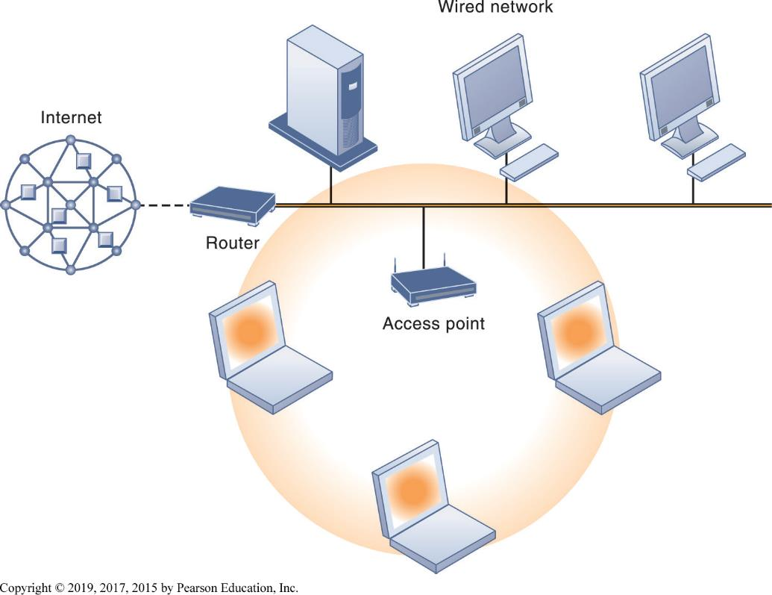
Figure 7.14 An 802.11 Wireless LAN

